Slide 1

AGE 310: Instrumentation and Measurements
Lecture 15: IoT & Smart Farming
Instructor: Dr. Kadeghe Fue
Department of Agricultural Engineering
Sokoine University of Agriculture (SUA)
The Final Frontier: Connecting Everything.

Slide 2


Recap & Objectives
The Journey So Far
Lecture 15 Objectives
We started with simple sensors (Lect 1-5), moved to signal conditioning (Lect 6), actuation (Lect 7), digital logic (Lect 8), and communication (Lect 9).
Define IoT in the context of Agriculture.
Understand the 3-Layer IoT Architecture.
Analyze Case Studies: Smart Irrigation & Livestock.
Today, we combine them all.
Discuss Big Data and Challenges in Tanzania.
Course Review & Exam Preparation.

Slide 3







What is "Smart Farming"?
Smart Farming is the application of IoT technologies to optimize the quality and quantity of products while minimizing human labor.
The "Things"
The "Internet"
The "Intelligence"
Sensors, Tractors, Drones, Cows. Everything is connected to the internet.
Data is sent to the Cloud (Servers) for storage and processing.
Data Analytics tells the farmer what to do, or robots do it automatically.

Slide 4
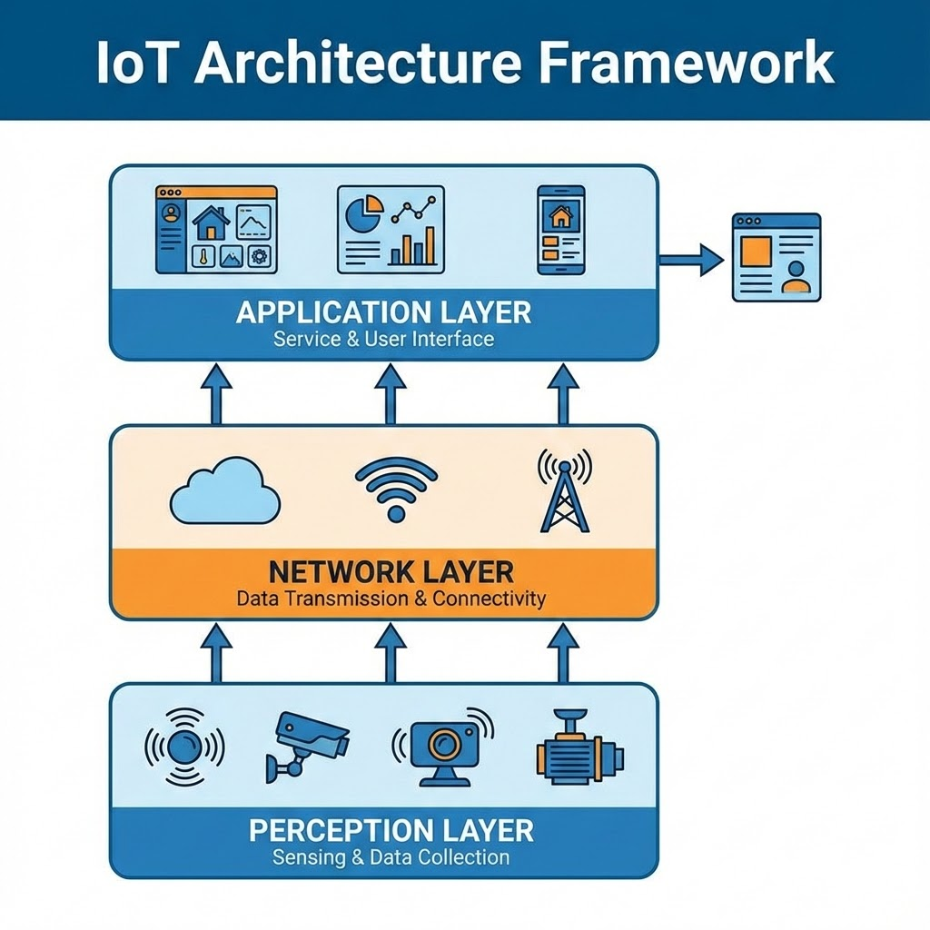

The IoT Architecture
1. Perception Layer
The physical skin. Sensors (Soil Moisture, Temp) and Actuators.
2. Network Layer
The nerves. Transmits data. (LoRaWAN, GSM, Wi-Fi).
3. Application Layer
The brain. Cloud servers, Databases, and the Dashboard on the farmer's phone.

Slide 5
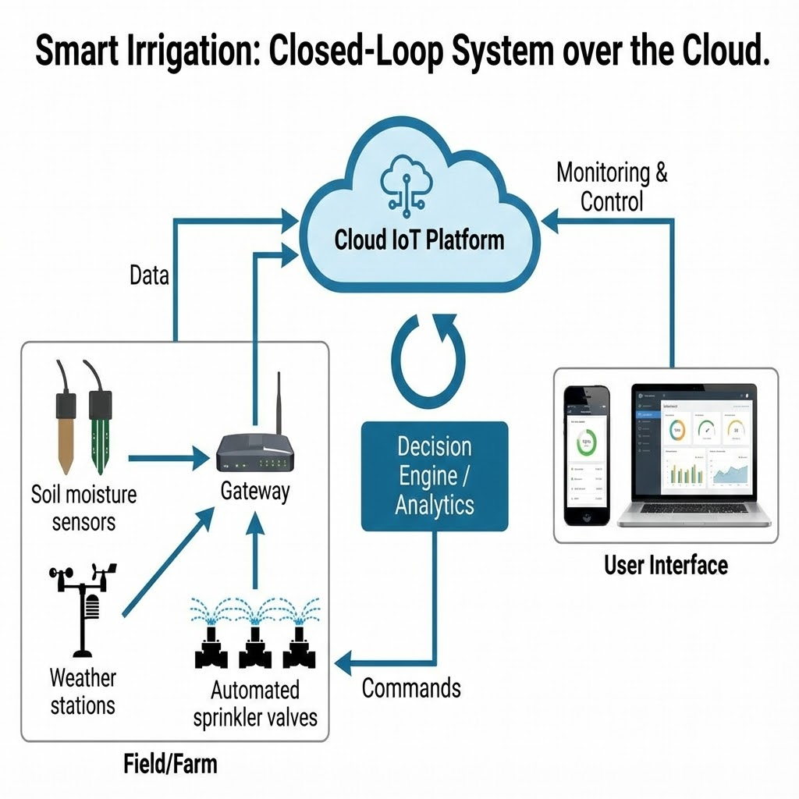
Case Study 1: Smart Irrigation
Closed Loop over the Cloud
1. Sensor: Capacitive Moisture Probe measures VWC.
2. Node: ESP32 sends data via Wi-Fi/LoRa.
3. Cloud: Compares VWC to threshold. Checks weather forecast.
4. Action: Sends command to solenoid valve to OPEN.

Slide 6
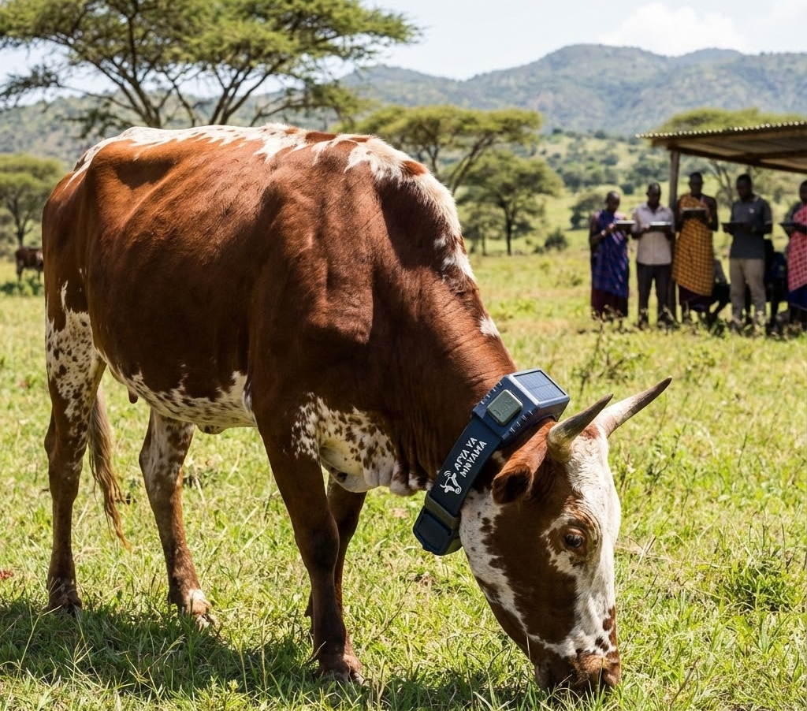
Case Study 2: Connected Cows
Smart Collars
Act like a "Fitbit" for cows.
Activity: High activity = Estrus (Heat). Time to inseminate.
Rumination: Low chewing time = Sick/Digestive issues.
Location: GPS Geofencing (Virtual Fences).

Slide 7
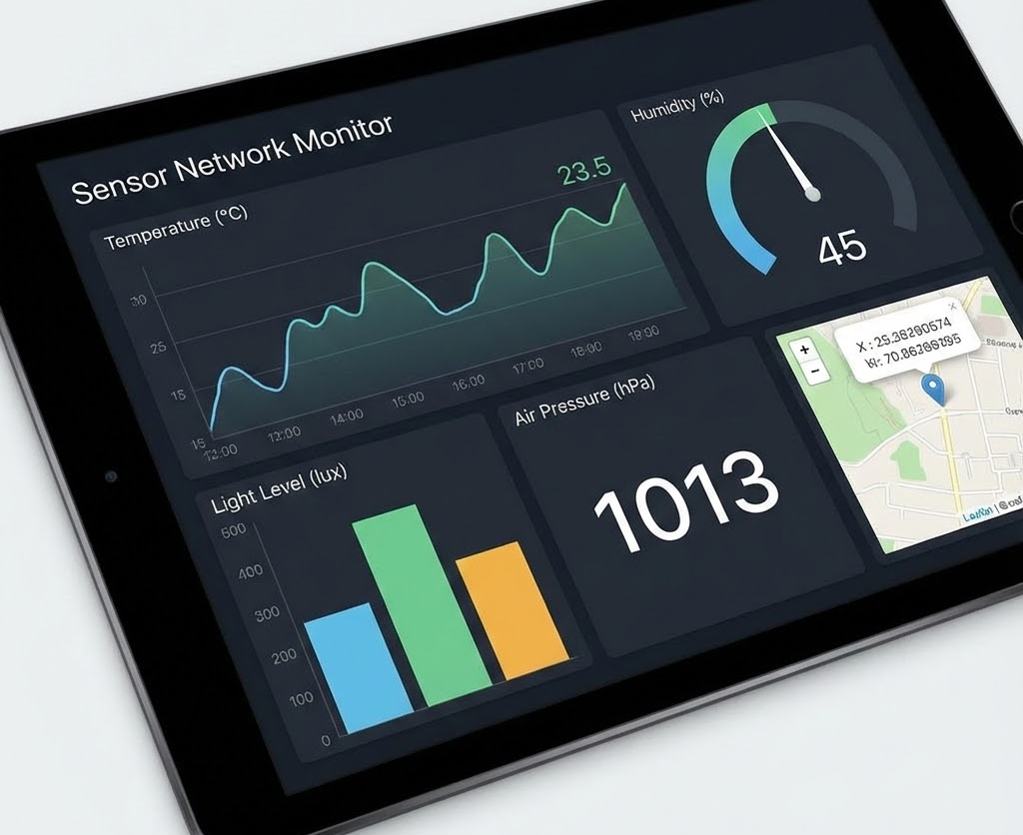
The User Interface (Dashboard)
Making Data Useful
Farmers don't want raw numbers. They want Insights.
A Dashboard (like ThingsBoard) visualizes:
Trends (Is the soil drying out too fast?)
Alerts (Pump failure! Tank empty!)
Maps (Which sector needs water?)

Slide 8
Challenges in Tanzania
Infrastructure
Human Factors
Connectivity: 4G/GSM is spotty in rural areas. We rely on LoRaWAN.
Cost: IoT devices must be affordable for smallholder farmers.
Power: Sensors must be Solar Powered as grid power is unavailable in fields.
Education: Farmers need training to interpret the dashboard data.

Slide 9






Future Trends
Artificial Intelligence (AI)
Blockchain
Swarm Robotics
Traceability. Proving to the buyer that this coffee was grown organically at SUA.
Fleets of small robots working together via IoT to weed and harvest.
Predicting crop yields and disease outbreaks before they happen using machine learning.

Slide 10
Course Review
From Sensors to Systems
A quick journey through AGE 310.

Slide 11
Module 1: Measurement Basics
Key Concepts
Typical Exam Question
GMS (Generalized Measurement System).
"Differentiate between Accuracy and Precision using a target diagram."
Static Characteristics (Accuracy, Precision, Sensitivity).
"Calculate the Sensitivity of a sensor given input/output data."
Dynamic Characteristics (0, 1st, 2nd Order).
Standards & Calibration.

Slide 12
Module 2: Sensors & Signal Cond.
Key Concepts
Typical Exam Question
Resistive (Pots, Strain Gauges).
"Design a Wheatstone Bridge to measure strain."
Capacitive (Moisture), Inductive (LVDT).
"Explain why an Instrumentation Amplifier is needed for a thermocouple."
Active (Piezo, Photoelectric).
Op-Amps, Filters, Bridges.

Slide 13
Module 3: Control & Automation
Key Concepts
Typical Exam Question
Actuators (Motors, Hydraulics).
"Compare Hydraulic vs Electric actuators for a tractor loader."
Digital Logic & Microcontrollers.
Control Loops (Open/Closed, PID).
"Draw the block diagram of a Feedback Control System."
Robotics & Machine Vision.

Slide 14
Exam Advice from Dr. Fue
Don't just memorize definitions. Understand the principle of operation.
Practice sketches. Be able to draw a generalized measurement system, a Wheatstone bridge, and an Op-Amp circuit.
Units matter. Always check your units in calculations (Sensitivity, Resolution).
Think like an Engineer. If asked to select a sensor for a specific job (e.g., measuring fuel level), justify your choice (Cost vs Accuracy).

Slide 15

Course Completed
Thank you for your attention throughout the semester.
Good luck with your exams!
Dr. Kadeghe Fue | AGE 310 | Sokoine University of Agriculture

